Slide 1
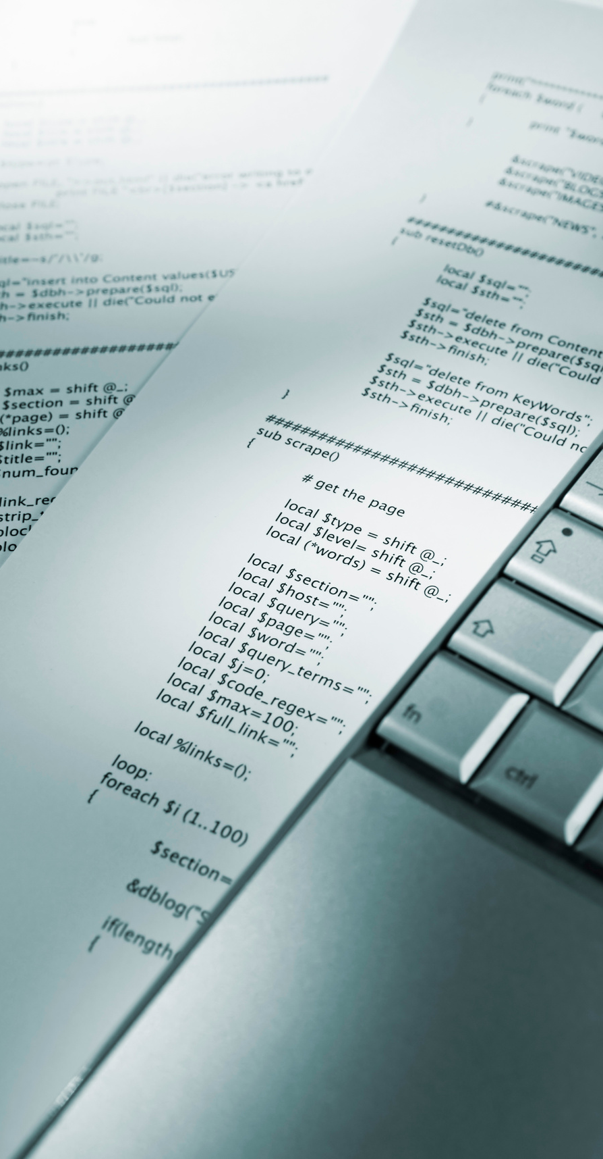
ITE61
SYSTEMS INTEGRATION

Slide 2

ITE61
Functional Silos
Silos are basically compartmentalized operating units isolated from their environment.

Slide 3
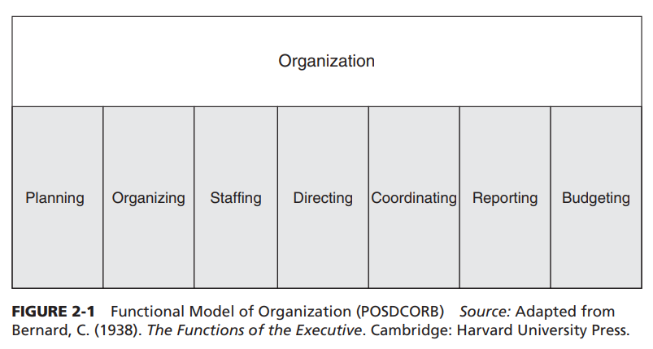
ITE61
Horizontal Silos
The current classification of organizations into divisions or departments like Accounting, Human Resources, Marketing, Management, and others reflects this evolution in organizations of breaking complex tasks into smaller manageable tasks that could be assigned to a group of people who could then be held responsible.

Slide 4
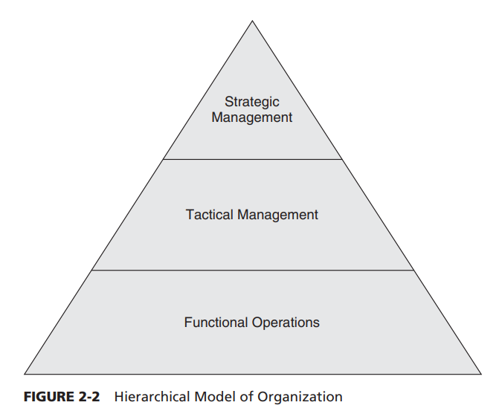
ITE61
Vertical Silos
In the late 1960s, Robert Anthony, an organizational researcher, at Harvard University, found that organizations also divided responsibility in hierarchical layers from strategic planning to management control and operation control.
When organizations get big and complex they tend to break functions into smaller units and assign one or more staff the responsibility for these activities. This allows the organization to manage complexity as well as the staff to specialize in those activities that enhance productivity and efficiency.

Slide 5
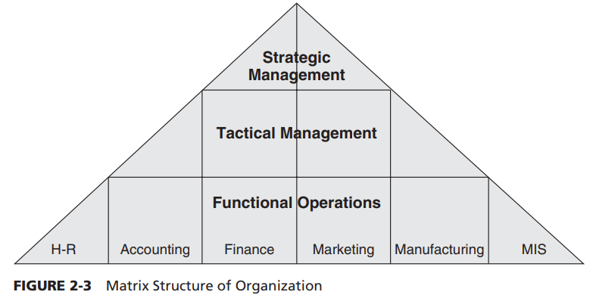
ITE61
Business Process and Silos
The cross-functional organizational structure breaks the traditional functional silos of an organization opening up the informational flows from one department to another.

Slide 6
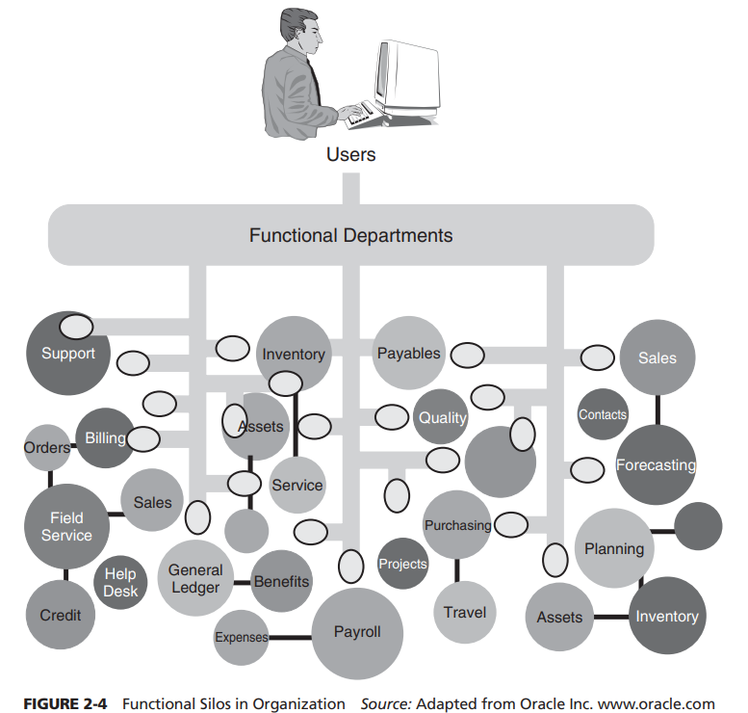
ITE61
Evolution of IS in Organizations
The essential problem with functional silos is that organizations design, manage, and reward their employees and managers by functional performance, yet they deliver value to customers via cross-functional processes

Slide 7
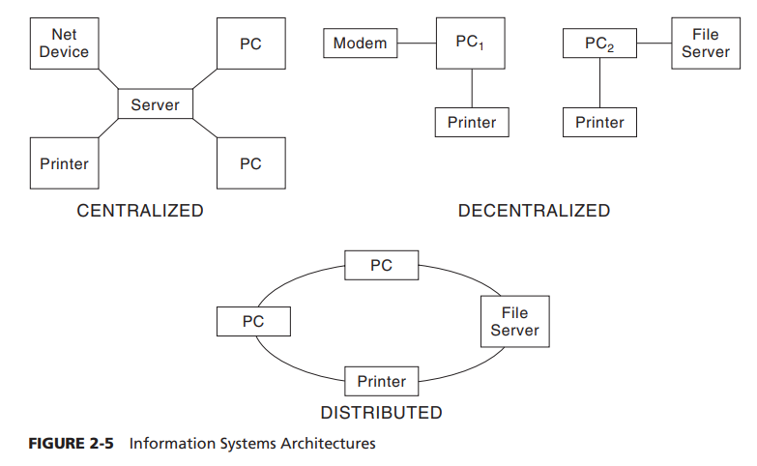
ITE61
IS Architectures
As with today’s Web-based systems, using a distributed architecture allows sharing of applications and data resources between the client and the server computers. It combines features from the centralized and decentralized architectures.
In this configuration, personal computers are connected via a network to a Web server that provides a window to an application and database server(s), which could be a mainframe or another type of computer

Slide 8
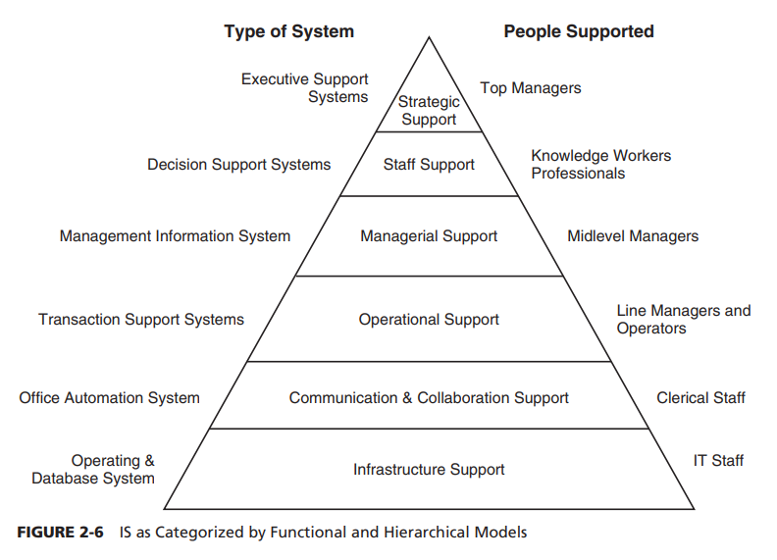
ITE61
IS Functionalization
In addition to serving the different management levels, IS also supports such major business functions as manufacturing, marketing, accounting, finance, and HR.
Management information systems (MIS) are reporting systems that categorize and organize information as required by the midlevel managers. These reports can be sales by product for a quarterly period, or they can be production schedules by manufacturing plants.

Slide 9
ITE61
Systems Integration
Integrated systems allow companies to accomplish something that has alluded most to date: the linking of demand- and supply-side functions in a way that enables a quick and flexible response to changes in demand.

Slide 10

ITE61
Logical vs Physical SI
At the logical or human level, systems integration means developing information systems that allow organizations to share data with all of its stakeholders based on their need and authorization.
On the other hand, at the physical or technical level, systems integration means providing seamless connectivity between heterogeneous application systems.
In order to achieve the logical integration and fit a company business model, organizational structures, processes, and employee roles and responsibilities need change.

Slide 11
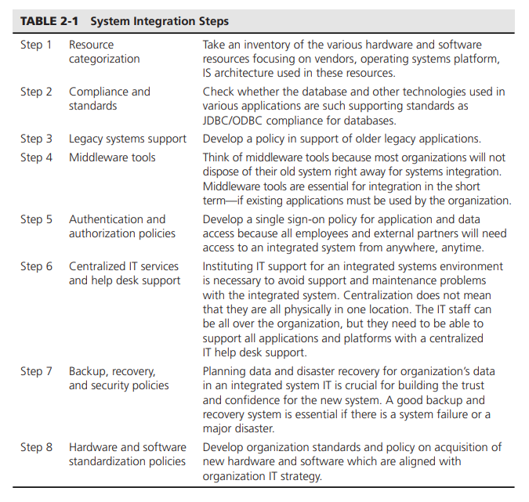
ITE61
Steps in Integrating Systems

Slide 12
ITE61
Benefits of SI
1
Increased Revenue and Growth.
2
Leveling the Competitive Environment.
3
Enhanced Information Visibility.
4
Increased Standardization.

Slide 13
ITE61
Limitations of SI
1
High initial setup costs
2
Power and interdepartmental conflicts
3
Long-term and intangible ROIs
4
Creativity limitations

Slide 14

ITE61
ERP and Systems Integration
Enterprise resource planning (ERP) systems are integrated, multimodule application software packages designed to serve and support several business functions across an organization. An ERP system is a strategic tool that helps the organization improve its operations and management by integrating business processes and helping to optimize the allocation of available resources.

Slide 15

ITE61
ERP’s Role in Logical Integration
At the logical level, ERP systems require organizations to focus on business process rather than on functions.
While ERP systems can address data integration, if business processes do not change, an organization will not be able to take full advantage of the ERP capabilities. The term is business process reengineering (BPR).

Slide 16
ITE61
ERP’s Role in Physical Integration
System integration is also necessary at the physical level. Before installing the ERP system, an organization may have to upgrade or install middleware and plan for the removal of their legacy system’s hardware and software
While ERP systems can address data integration, if business processes do not change, an organization will not be able to take full advantage of the ERP capabilities. The term is business process reengineering (BPR).

Slide 17
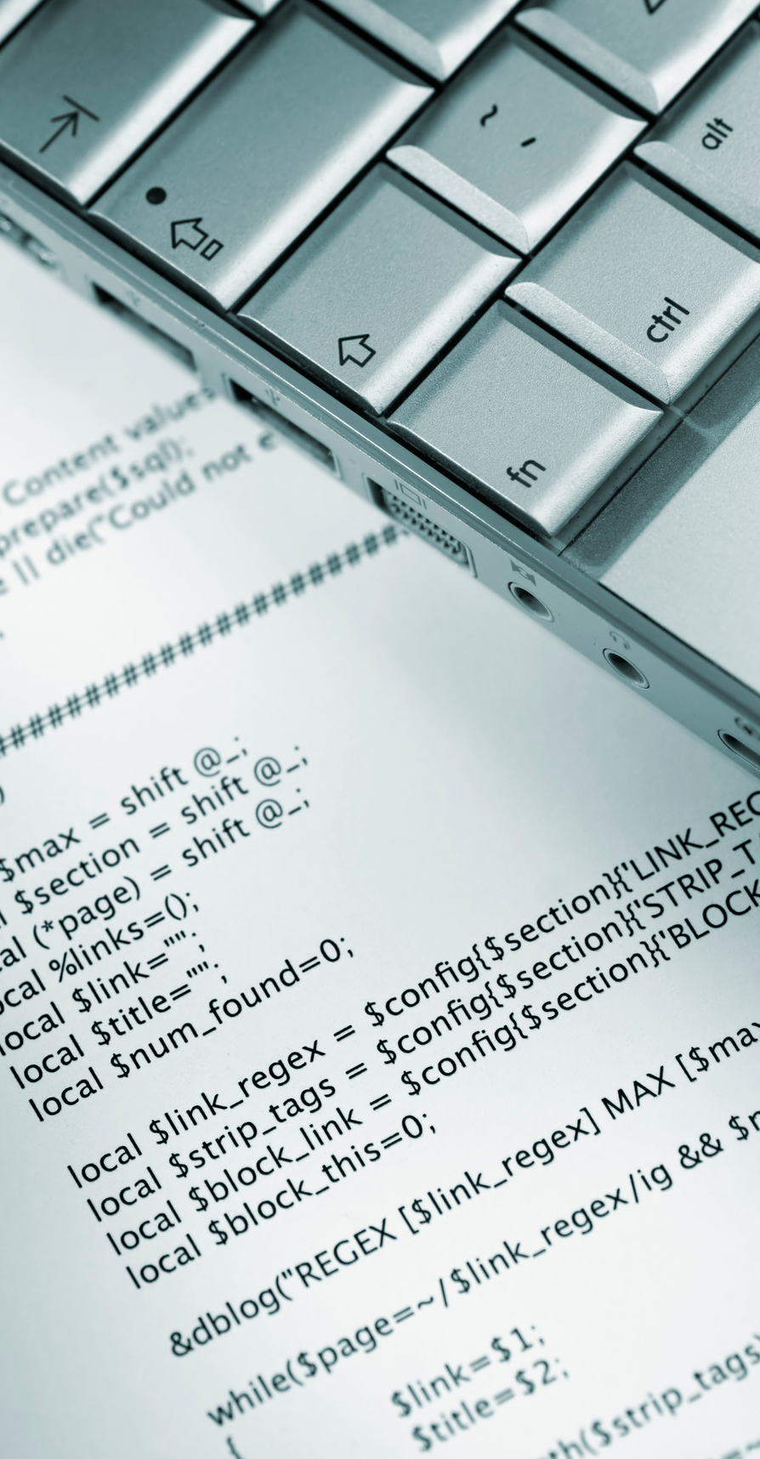
ITE61
Thank You For Your Attention!

